Slide 1
Programming tutorial course
Dr Michael Berks
michael.berks@manchester.ac.uk
Lesson 1: Why learn to program? Python vs Matlab;
The Basics: variables, scripts and functions

Slide 2


Why do I need to learn ‘it’?
What is Matlab?
What is python?
Because the course leader said so…

Slide 3
What is Matlab/python?
What is a computer program?
What does computer programming mean?
What is a programming language?
What is code?

Slide 4
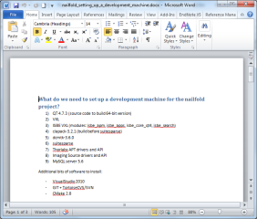
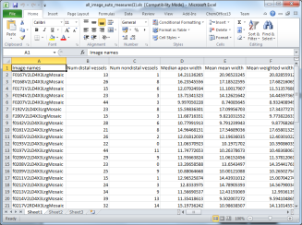

What is a computer program?
Something you use to achieve some task on a computer (or phone, tablet etc)…
Word
Write a letter, essay, lab report etc…
Excel
Analyse results, produce graphs for your report etc…
Angry Birds
Kill time when you’re sitting in boring programming lectures…

Slide 5

What is a computer program?
In medical imaging…
DATA
Image(s)
PROGRAM
RESULT
Lab results
Hopefully clinically useful!
Patient data
Do something clever…

Slide 6
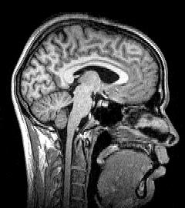
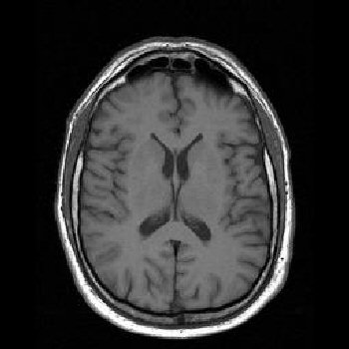
What is a computer program?
In medical imaging…
DATA
PROGRAM
RESULT
Predict whether the patient has Alzheimer’s Disease
MR images of the brain
Measure volume of grey/white matter…

Slide 7

What is a computer program?
In medical imaging…
DATA
PROGRAM
RESULT
Predict risk of developing breast cancer
Mammogram acquired during routine screening + patient data
Measure amount dense breast tissue…

Slide 8
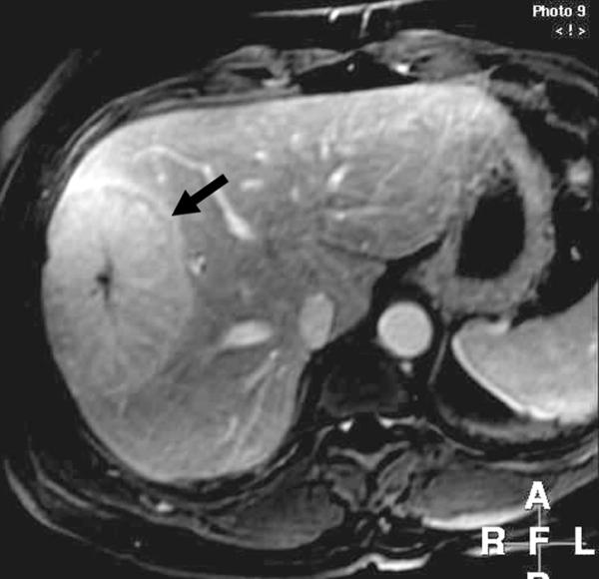
What is a computer program?
In medical imaging…
DATA
PROGRAM
RESULT
Tell doctor/drugs company if the drug is working
MRI liver tumours before and after drug treatment
Measure change in size of tumour…

Slide 9
What does computer programming mean?
Writing your own computer programs...
… telling the computer to do exactly what you want.
What is a programming language?
A way of translating human logic into commands a computer understands…
… like human languages, there a lots of different languages (often similar to each other), each with a specific set of rules (syntax, grammar) to obey.
A chunk of commands in a specific programming language…
What is ‘code’?
A program consists of bits of code put together in a logical way …
… by using other people’s code, you can incorporate bits of their program in your own (as long as you’re using the same language!).

Slide 10
Now the big question….
Why do I need to learn how to write my own computer code?
Think of it like learning to cook…..

Slide 11

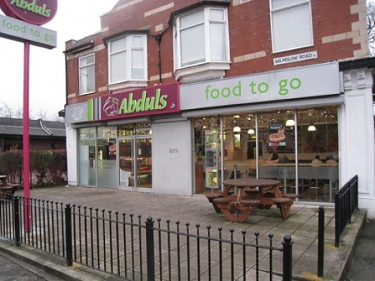


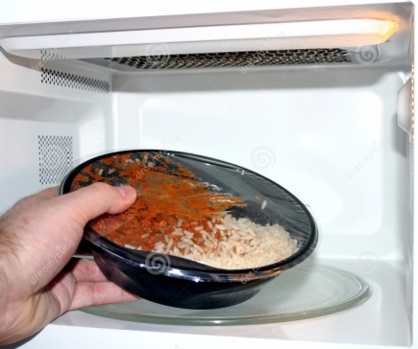
x
x
You live in Manchester now!
You’re student, you can’t afford it!
Go to a restaurant
You’re hungry and want something good to eat…..
Get parents to cook
x
Get a microwave meal
You’re a fussy eater!

Slide 12
Heating someone else’s food in the microwave
Using a computer program
Ok if they’ve cooked exactly what you want
Ok if it does exactly what you want
Vs
Vs
Cooking your own food
Writing your own computer program
Can eat exactly as you like it
Make it do exactly what you want
Research is likely to be here

Slide 13
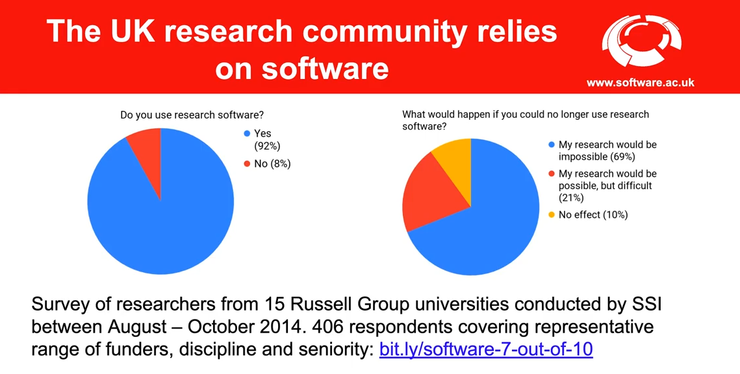

Slide 14
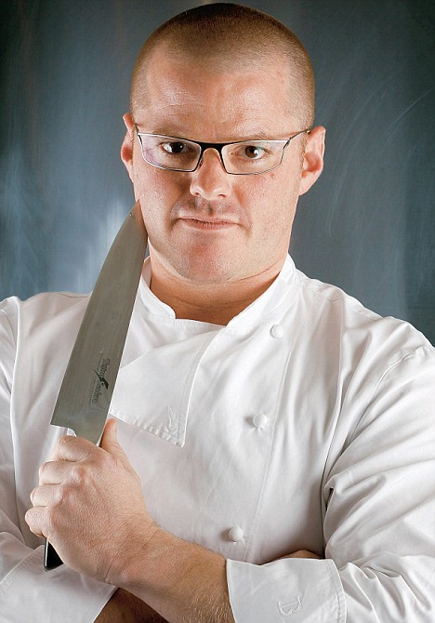
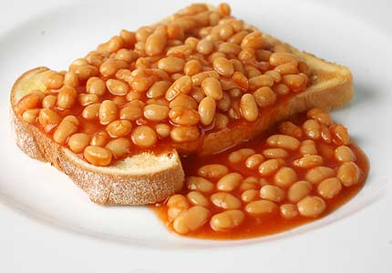
How good a cook/programmer do I need to be?
Vs
Do I need to write all my programs from scratch?
No! Just like in cooking, you don’t need make everything from raw ingredients, can use pre-made pasta, sauces, wine etc…
Remember you can use other people’s code to include bits of their programs in yours …
… but you do need to know the basics to put those bits together (how to chop an onion, when to add seasoning etc.)

Slide 15

And finally….
What is Matlab?
Matlab is both a program and a programming language ...
… it has lots of tools you can just use to analyse data and images. But you can also write code to extend it to do any analysis you like (although unlike a ‘pure’ language, it will only work if the Matlab program is installed on the computer).
Excel
Photoshop
+
+
Using other people’s code
+
Writing your own code
=
A really powerful tool for imaging research!

Slide 16

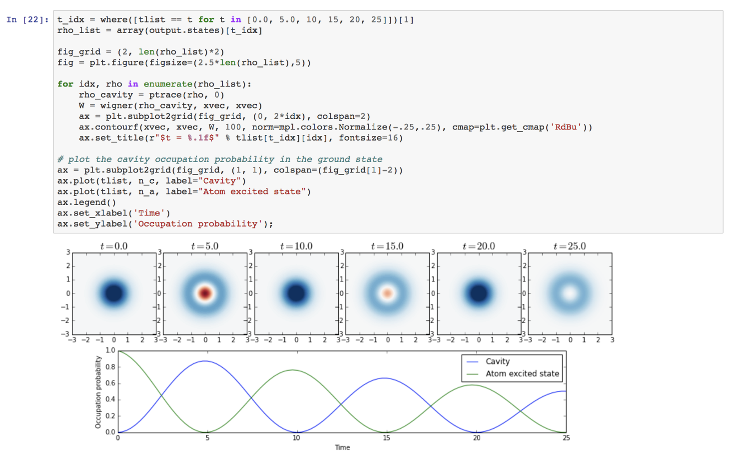
But what about….
Python?
General purpose programming language
Packages provide support for scientific computing
Open-source
Notes:
Image source: http://nbviewer.jupyter.org/github/jrjohansson/qutip-lectures/blob/master/Lecture-1-Jaynes-Cumming-model.ipynb

Slide 17

How does python differ from Matlab?
It’s free
  No need for an expensive license*
  Widely used, both in academia and industry
  Often installed as part of OS
No single development environment
  This can make it a little trickier get started
  But, also more flexible
  We’ll use Spyder on this course
*Currently free because of COVID, but usually you have to pay for Matlab!

Slide 18
Course aims
To show you how to use Matlab and/or python
To introduce some basic programming ideas common to all programming languages
To give examples of some tasks in medical imaging processing
To provide code you can reuse later in your projects
To make some pretty pictures!

Slide 19
I’m a bit confused…
Should I use Matlab…
..or Python?

Slide 20
For this course, consider Matlab and python as interchangeable… you can use either or both.
I will demonstrate mainly in Matlab, but everything we do will be very similar in both… just watch out for the subtle differences!

Slide 21
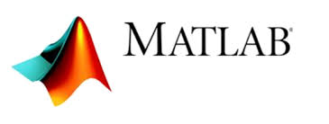

vs
If you see this I’m referring to Matlab only
If you see this I’m referring to differences in python

Slide 22
First tasks
Open Matlab (if you have it installed)
Open Spyder (if you have it installed)
Open a windows explorer window
  Go to the MSc folder you created for Professor’s Cootes, maths course
  Make a new folder Programming
  Inside Programming, make new folders:
    Matlab
    Python
    Data
    TutorialSlides

Slide 23
First tasks
Open an internet explorer/Google chrome window
Go to the following webpage:
  http://personalpages.manchester.ac.uk/staff/michael.berks
  Click on the Matlab Tutorial tab
  Bookmark this page for future weeks
Save the week 1 powerpoint slides and tutorial exercise into the TutorialSlides folder
  These will also be added to the ‘Course content’ section of blackboard
Leave the window open (we’ll need it later)
Open the ‘lesson 1’ powerpoint file you’ve just saved
  As I’m going through the slides, follow them on your computer

Slide 24
Lesson Overview
Using the Matlab/Spyder interface
Doing maths in the Command Window
Assigning variables and suppressing visual output
Collecting sequences of commands: scripts
An introduction to functions
Basic programming tips: expressive variable names and comments

Slide 25
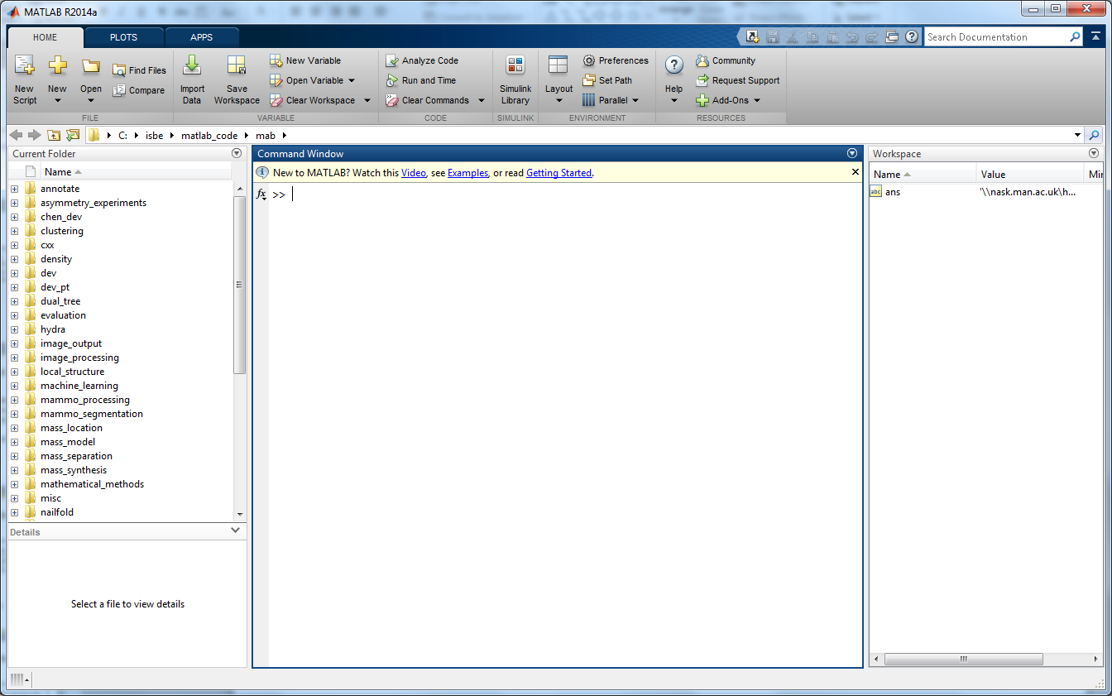
Command window

Slide 26
Command window
A fancy scientific calculator
  2+3
  2*3
  2/3
  2^3
    Our first python difference! It’s 2**3 in python
  2^0.5
  2+3*6/2
  (2+3)*6/2
Try using ↑ and ↓
  Select earlier expressions and edit them
Any of the text in navy blue is code you can run in the command window. Try copy and pasting, then hitting return

Slide 27
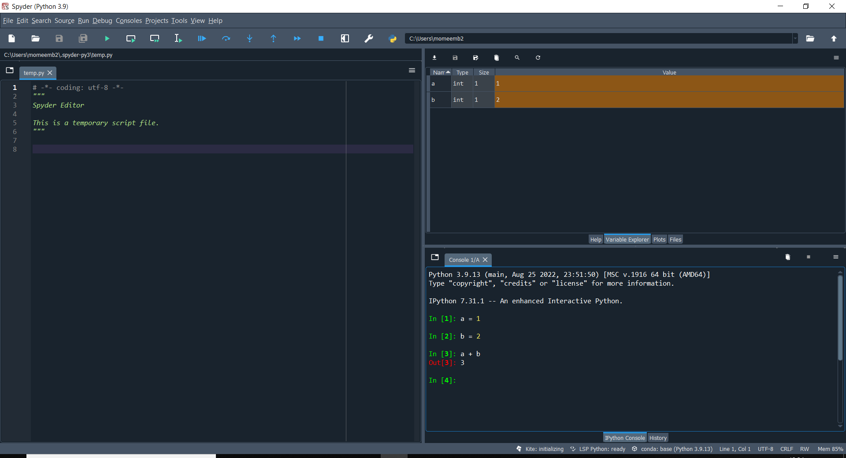
In Spyder: console

Slide 28
Assigning Variables
Use ‘=‘ to assign variables
  Keeps data in memory to use again
  a = 4
  b = 3 + 6
  y = (4*a^2 +3*b^3) / 5
Can also self-assign:
  b = b*2
Check the work space

Slide 29
Workspace
Shows you what variables are currently stored in memory

Slide 30
Workspace
Shows you what variables are currently stored in memory

Slide 31
Suppressing visual output
Try a = rand(100)
This creates a 100 x 100 matrix of random numbers
Use clc to clear the Command Window
Try a = rand(100);

Slide 32
Let's compute the number of seconds in a year…
Let's create some variables
  seconds_in_minute = 60
  minutes_in_hour = 60
  hours_in_day = 24
  days_in_year = 365
Then compute:
  seconds_in_year = seconds_in_minute* minutes_in_hour*hours_in_day*days_in_year

Slide 33
Scripts
Use clear to wipe the current memory
  Check that the workspace is now empty
Click the ‘New script’ button (top left of main menu)
  Opens a blank page in the editor
Copy the previous commands to compute the number of seconds in a year from the Command History
Paste them into the blank document
Save the document as
  Matlab: programming_tutorial_lesson1_script.m
  Python: programming_tutorial_lesson1_script.py

Slide 34
Calling a script from the command-line
Type: programming_tutorial_lesson1_script at the command line
Note the lack of ‘.m’
Check your work-space
We'll look at different ways of calling python scripts in future lessons

Slide 35
How many seconds in…
2 years?
10 years?
N-years?
Scripts are useful… but if we want to re-run our script with different inputs, we should use a function

Slide 36
Matlab Functions
In our script, type %%
This creates a new cell – a part of a script that can be run separately
Now at the BOTTOM of the script …
  function [seconds_in_n_years] = compute_seconds_in_years(n_years)
  seconds_in_minute = 60
  minutes_in_hour = 60
  hours_in_day = 24
  days_in_year = 365
  seconds_in_year = seconds_in_hour *hours_in_day*days_in_year
  seconds_in_n_years = n_years * seconds_in_year
  end
Type another %% above the function, then
  compute_seconds_in_years(2)

Slide 37
Python Functions
Again type %%
Now type …
  def compute_seconds_in_years(n_years)
  seconds_in_minute = 60
  minutes_in_hour = 60
    hours_in_day = 24
  days_in_year = 365
  seconds_in_year = seconds_in_hour *hours_in_day*days_in_year
  seconds_in_n_years = n_years * seconds_in_year
  return seconds_in_n_years
Run this cell, no output is generated but the function is now available to use…
Type another %%, and then:
  compute_seconds_in_years(10)

Slide 38
What differences did you spot between the Matlab and python functions?
vs

Slide 39
Inputs and output
The variable n_years is an input to our function
You will often see this described as an argument
The variable seconds_in_n_years is the output of our function
We look next at using multiple inputs
We can also have multiple outputs but will see those in future lessons

Slide 40
Exercises
Lookup ‘Newton's law of universal gravitation’ (yes, you can use wikipedia)
In Matlab, use the command prompt to compute the force of attraction between the moon and the earth
  You can assume
    Earth’s mass: 5.97x10²⁴ kg
    Moon’s mass: 7.35x10²² kg
    Distance from earth to moon: 380,000km
    Gravitational constant: 6.674×10⁻¹¹ N m² kg⁻²
Rewrite this as a function that takes as input, M₁, M₂ and r
Use commas to separate multiple inputs to your function
Can we write this in python?

Slide 41
Variable, script and function names
Must start with a letter
Followed by any number of letters, digits, or underscores.
Matlab and python are case sensitive
  A and a, my_fun and My_fun, etc are not the same name
Certain keywords cannot be used
  if, for, end, etc
Be expressive: try and use names that
  Describe what functions do
  Describe what variables are

Slide 42
Scripts summary
Scripts allow us to run sequences of commands
All data is stored in the main workspace, as if we typed the commands in the command window
We can run parts of scripts by
  Selecting text and hitting F9
  Using %% to create ‘cells’
Even when ‘hacking around’ use scripts, date tagged (e.g. work2013_02_11) to run commands
  That way you have a record of your work
  Think of them as your Matlab/Python lab book

Slide 43
Functions summary
Functions group commands so that we can run them with different inputs
We have looked at defining and calling functions inside scripts
Next week we will look at how we can call functions from other places (hint: you've already done this!)
Matlab and python have 1,000s of in-built functions, by learning how to call those we can create really powerful programs

